Slide 1


Key Areas of
Mathematical Development
Key Areas of Mathematical Development V0.1 2 December 2024
Notes:
Today we will be talking about the Key Areas of Mathematical Development so we can move forward in our Maths Champions Journey.

Slide 2
Aims of the session
Describe why maths in the early years is important
Identify the key areas of mathematical development
Discuss the Maths Champions audit process and identify next steps
Notes:
Read or ask staff to read the aims
There will be a little knowledge check in the form of a few questions toward the end of the session. This is to help you reflect on what areas you feel confident in and where you might want to develop your knowledge and confidence further.

Slide 3
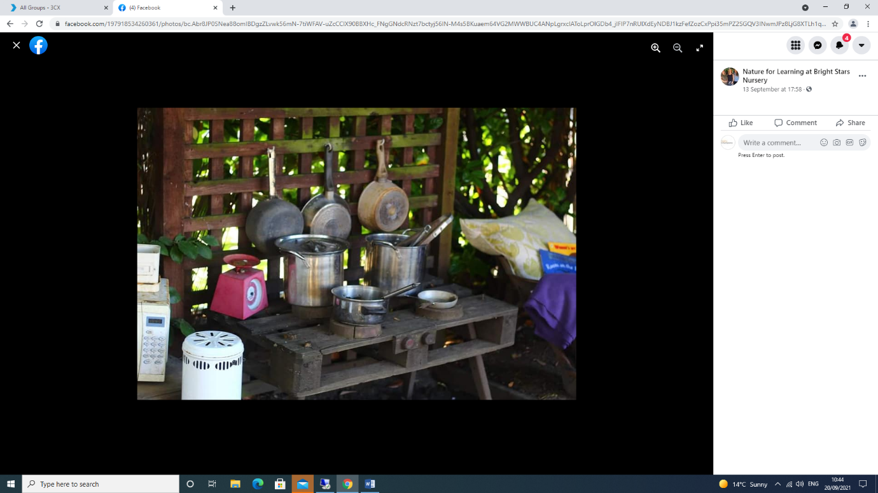
Maths in the early years
Research shows that early mathematical knowledge predicts later mathematical and reading ability and general education and social progress.
It is essential that early year's educators provide all children with opportunities to develop firm foundations in maths, in ways that are engaging and appropriate for their age and stage of development.
Notes:
Read slide

Slide 4
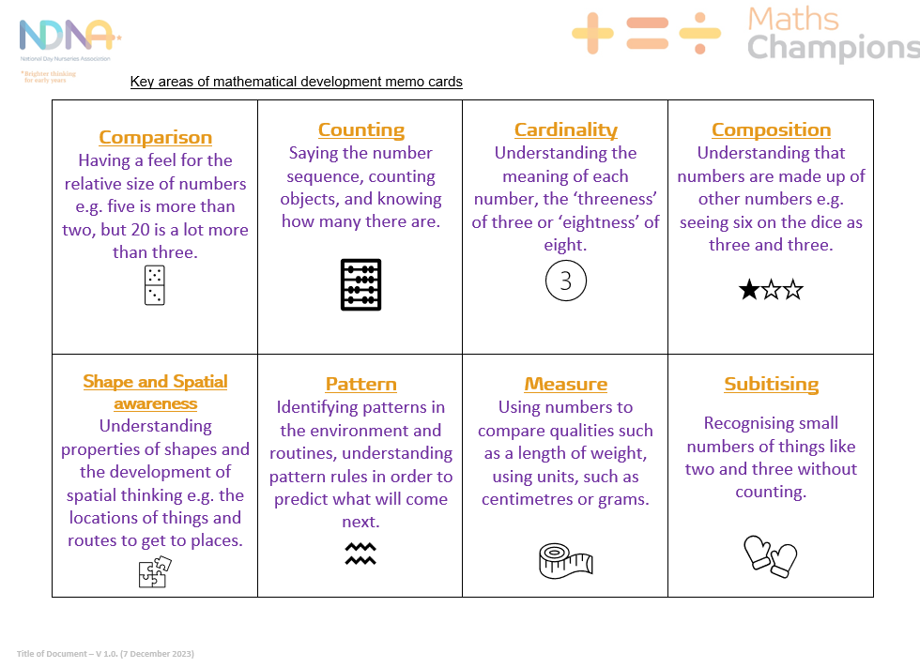
Key areas of maths learning
Comparison
Counting
Cardinality (including subitising)
Composition
Shape and spatial awareness
Pattern
Measures
Notes:
Throughout the Maths Champions Programme there are key areas of maths learning that help children to develop strong number sense, shape and spatial awareness and their understanding of pattern and measures. Many of these areas cross over and interlink. This session will help to define each of these key areas so as a team we can look at what opportunities we currently offer and what new experiences we could offer moving forward.
Handouts for practitioner
Glossary of key terms
Key areas maths big memo cards

Slide 5
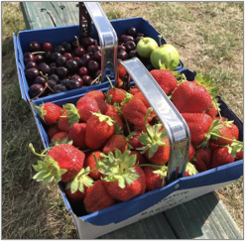
Comparison
Showing understanding of the relative size of number
Estimating and comparing amounts
Recognising changes in numbers and estimating numbers of things.
Notes:
Number sense comparison refers to the understanding of the relative size of number. Estimating and comparing amounts, recognising changes in numbers and estimating numbers of things.
Comparison starts very early on as babies' attention is naturally drawn to groups with larger amounts. Through experience they then begin to compare and recognise changes in numbers of things, using words like more, lots or ‘same’. This then leads to the use of number names and symbols when comparing numbers and estimating. For example, five is more than two but 20 is a lot more than three.
Optional Video (12 mins)
Comparison https://youtu.be/HO_b--fLp8g
Handout for practitioners
How Do children Learn to Compare and How Can Practitioners Help?
Optional discussion
What opportunities do we have for children to experience comparison of amounts?
What new experiences could we provide for children to experience comparison of amounts?

Slide 6

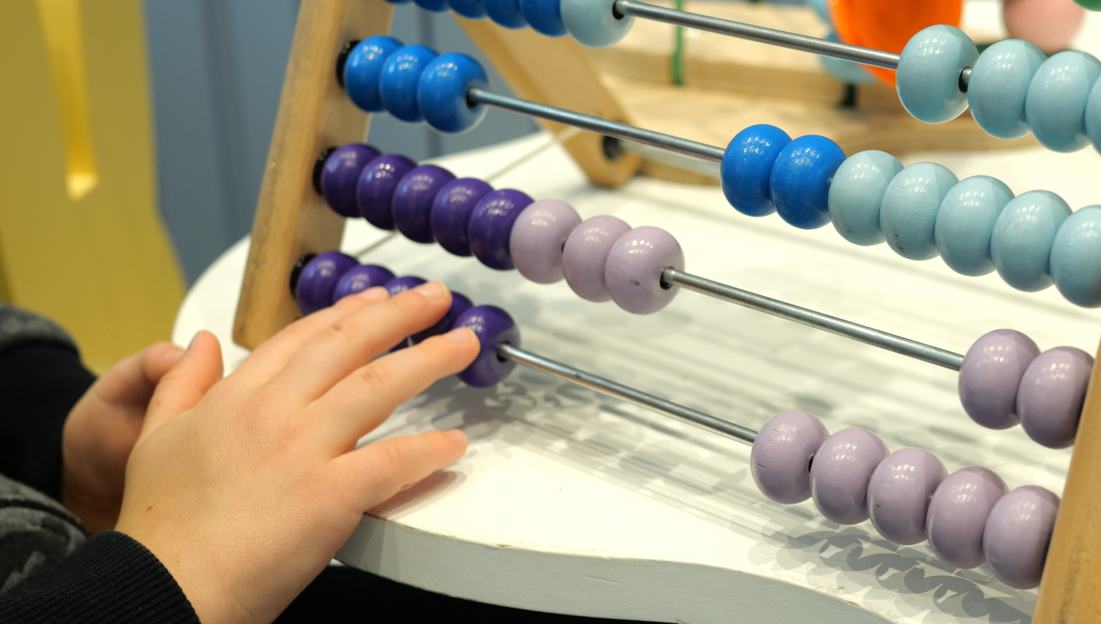
Counting
Understanding number/s
Developing counting skills including saying number words
Counting in everyday contexts
Tagging numbers to objects (one to one)
Counting on from a number
Matching number names to numerals.
Saying the number sequence or saying some numbers in sequence
Notes:
Counting refers to understanding number/s and developing counting skills including saying number words, saying the number sequence or saying some numbers in sequence, counting in everyday contexts, tagging numbers to objects (one to one), counting on from a number and matching number names to numerals.
Optional Video (24 mins)
Counting https://youtu.be/8dno6yg0BuI
Handout for practitioners
How Counting Develops (but Children Vary) and How Practitioners Can Help
Optional discussion
Think about what is involved when children are counting a group of objects - what do they need to remember to do? (counting sequence, tagging the objects and remembering the stopping number).

Slide 7

Cardinality, including subitising
Cardinality
The quantity (number of things) or ‘how-many-ness’ of things it represents.
Cardinal understanding is developed through counting and subitising skills.
Subitising
Instantly recognising the number of objects in a small group without the need to count them.
Notes:
Cardinality refers to the quantity (number of things) or ‘how-many-ness’ of things it represents. It relates to understanding the meaning of each number, the 'fiveness' of five or 'eightness of eight. Research has shown that modelling saying how many there are altogether (to show that the last number of the count tells you how many there are) is the most effective way to help a child who does not understand the cardinal counting principle.
Cardinal understanding is developed through counting and subitising skills.
Subitising refers to the ability to instantly recognising the number of objects in a small group without the need to count them. It has been shown that babies can recognise the difference between two or three things without counting based on their deeper attention to three things compared to two.
Optional Videos
Cardinality https://youtu.be/9nzOMunbjKM (12 mins)
Subitising https://youtu.be/RdeqfxTzEw0 (10 mins)
Optional Discussion
Discuss why subitising is important for number sense. (Subitising is important for the visual recognition of small amounts without the need to count.)
How can we support subitising and how it might be incorporated more into daily activities (e.g. spotting two shoes, gloves, swings, etc.)
Handout to support practitioners
How Cardinality Develops (but children vary) and How Practitioners Can Help.

Slide 8

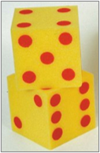


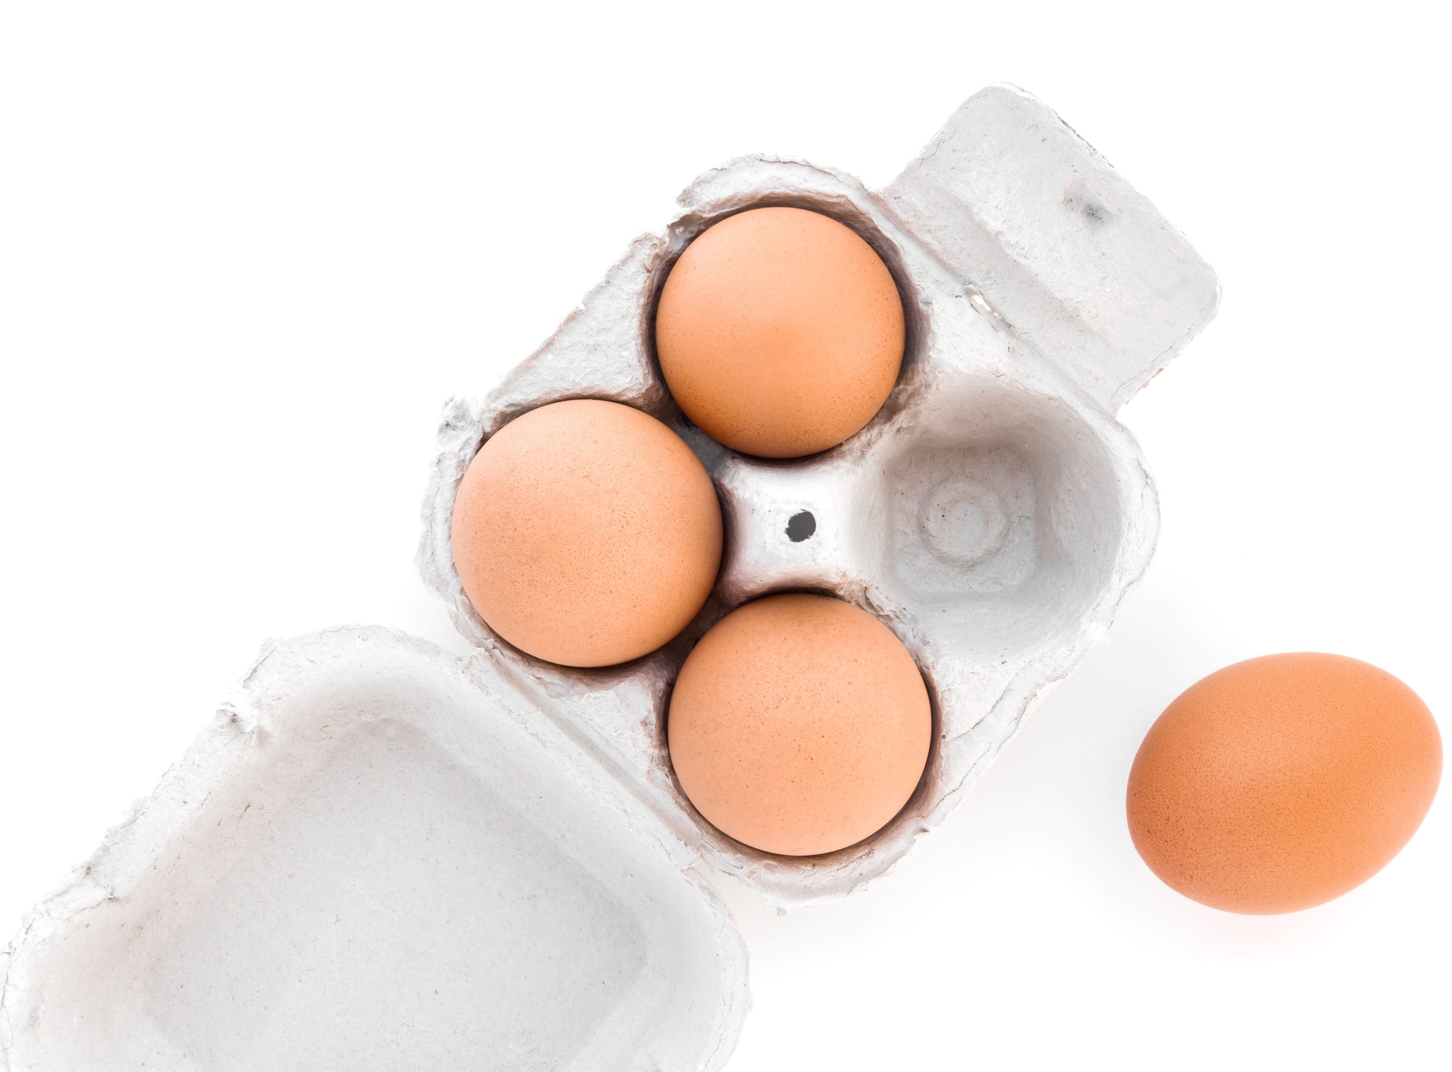
Composition
Understanding that one number can be made up from combinations of two or more smaller numbers.
Notes:
Composition refers to understanding that one number can be made up from combinations of two or more smaller numbers. Children need a solid understanding of cardinality before they develop this 'part-whole’ recognition. Initially children may use subitising skills to spot doubles on dice e.g. two and two dots inside four dots and learn that each individual number includes the previous number plus one more. This is the foundation for understanding addition and subtraction as linked operations and later number combinations which helps primary school age children to solve problems without having to count.
Optional Video (12 mins)
Composition https://youtu.be/bxlF6dpfbSQ
Optional activity
Discuss the different arrangements that can be seen in the egg box pictures (e.g., for the box of six eggs, you can see two, two and two, or three and three, or four and two/two and four).
Optional discussion
Which activities support composition in our setting? What else can we do?

Slide 9

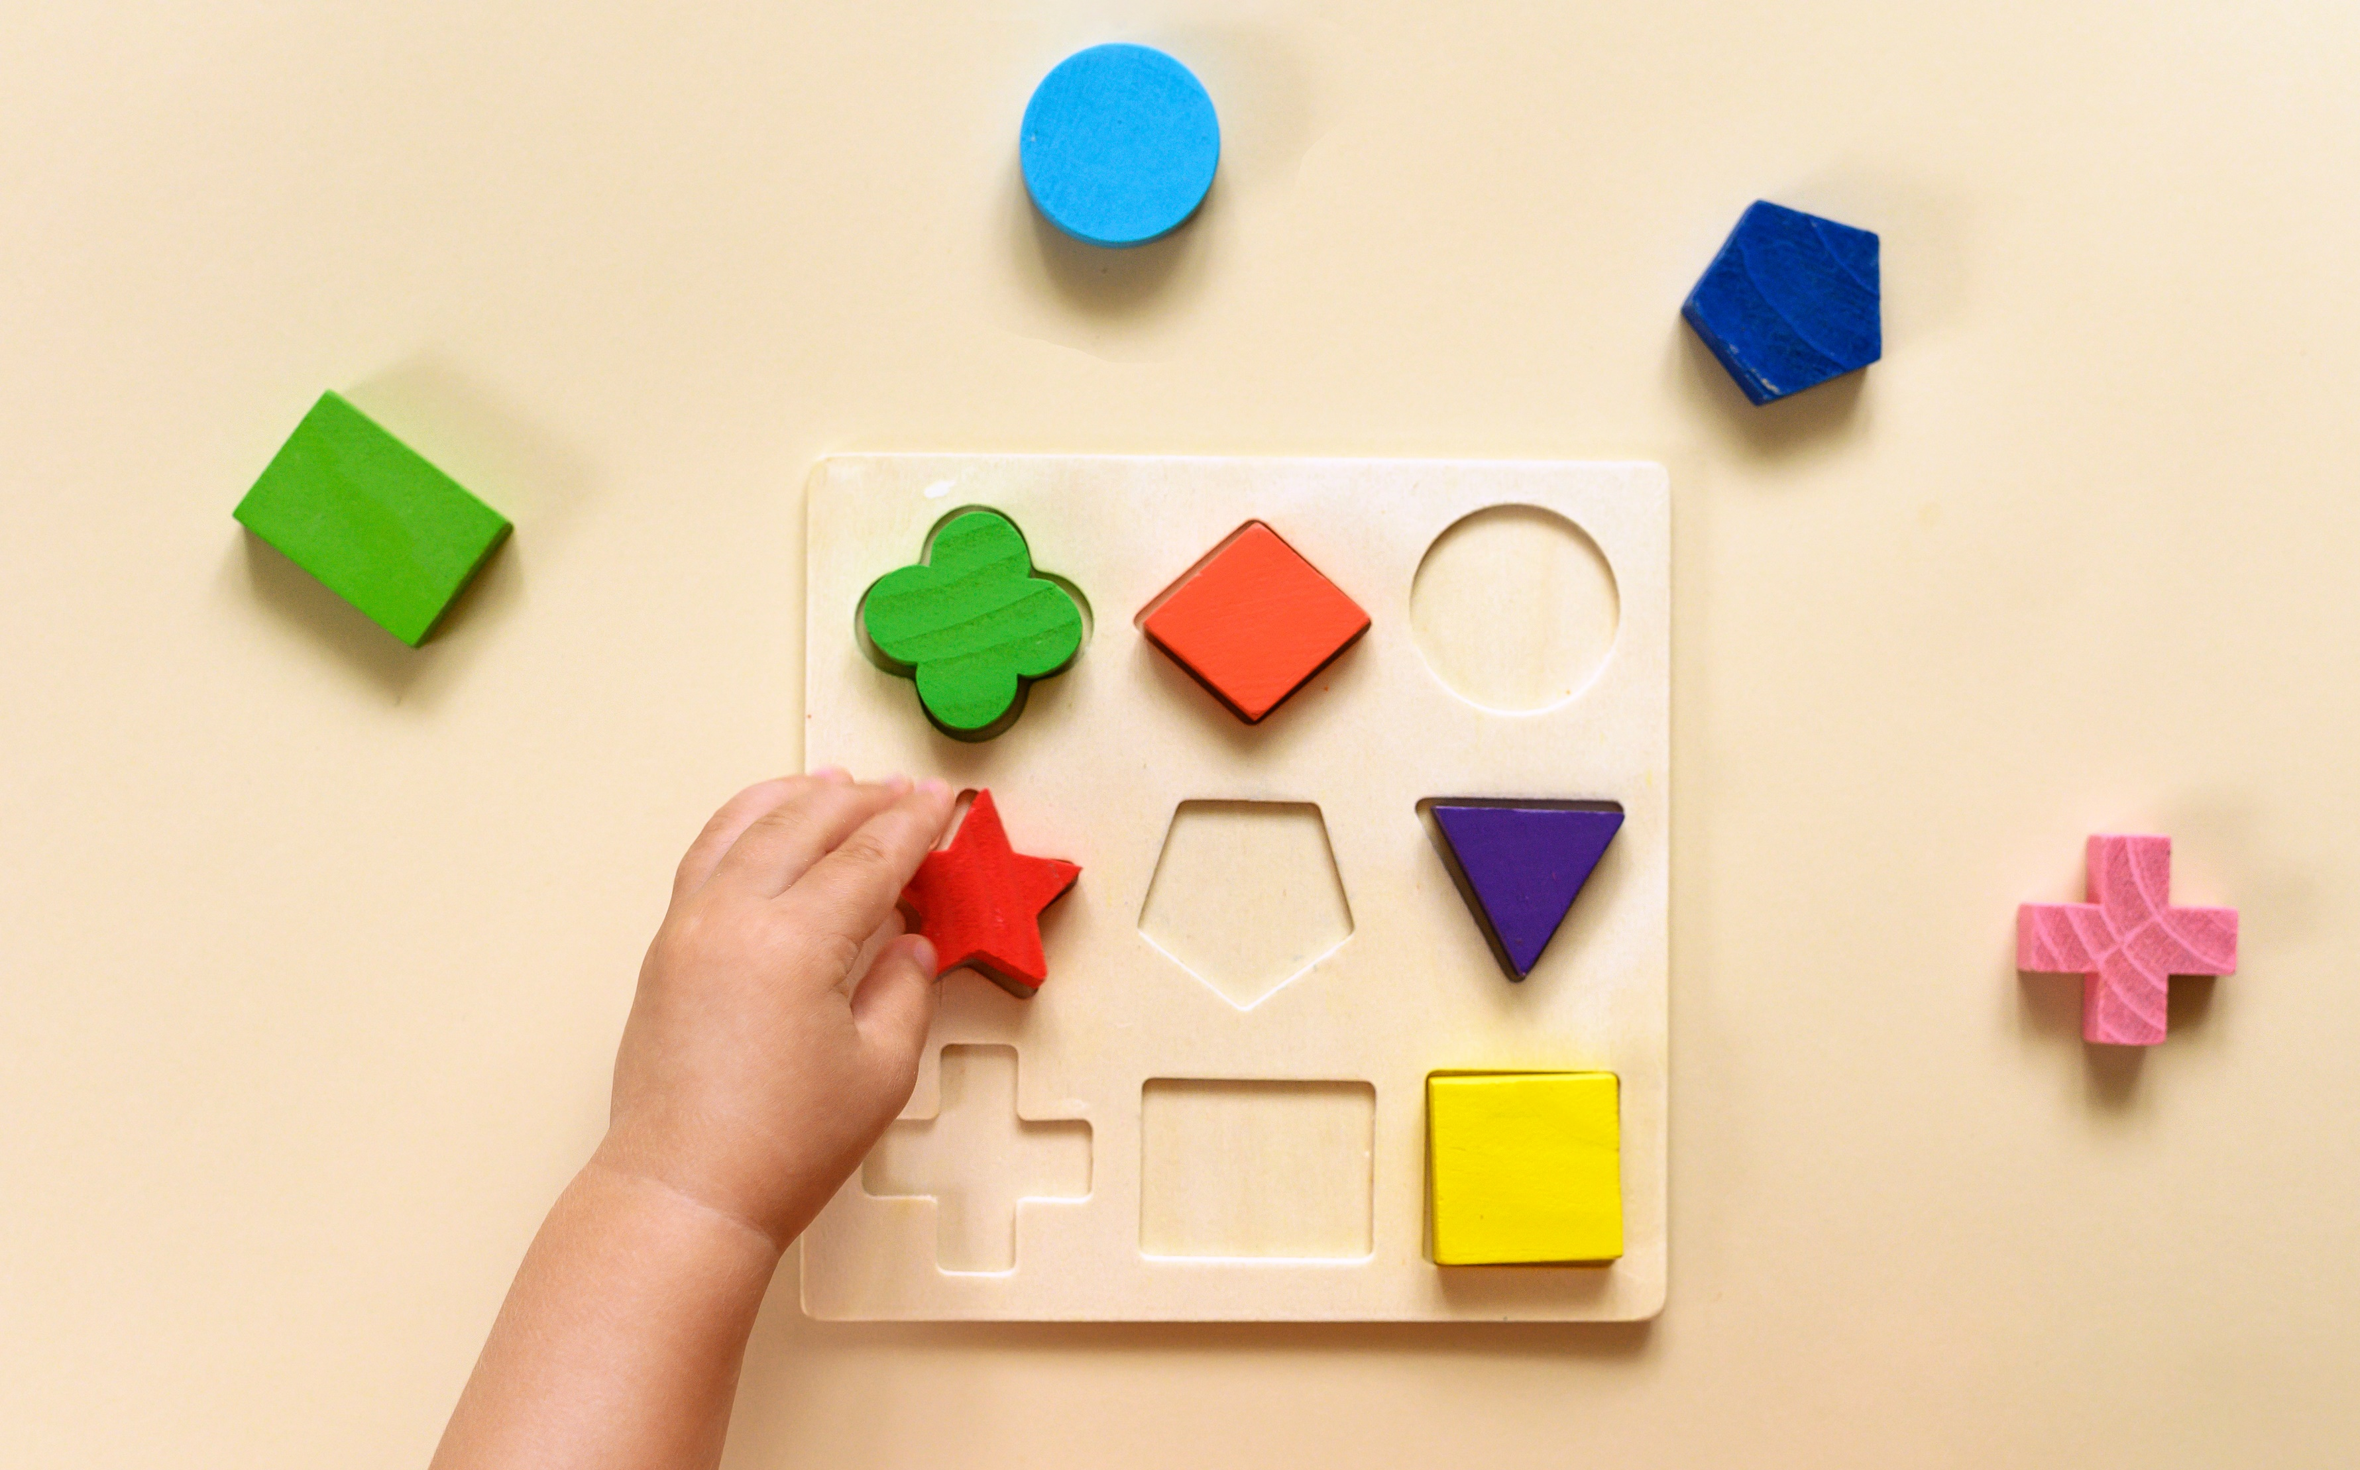
Shape awareness
Noticing simple 2D and 3D shapes
Recognising when shapes are the same
Categorising according to shape
Using shape for a purpose to solve problems
Understanding and using mathematical terms for shape and shape properties.
Notes:
Shape understanding is about noticing simple 2D and 3D shapes, recognising when shapes are the same, categorising according to shape, using shape for a purpose to solve problems and understanding and using mathematical terms for shape and shape properties*.
*For example, for curvedness or straightness: curved, round, or straight (flat for 3D solid shapes) and informal language such as bendy, bumpy, wavy, wiggly, looping, zigzag and for angle size: smaller or larger than a right angle and informal language such as pointy, sharp corner, square corner, sloping
Optional discussion
What activities do we do which support the development of shape understanding and language? (E.g. puzzles, construction, shape sorters, loose parts play, etc.)

Slide 10
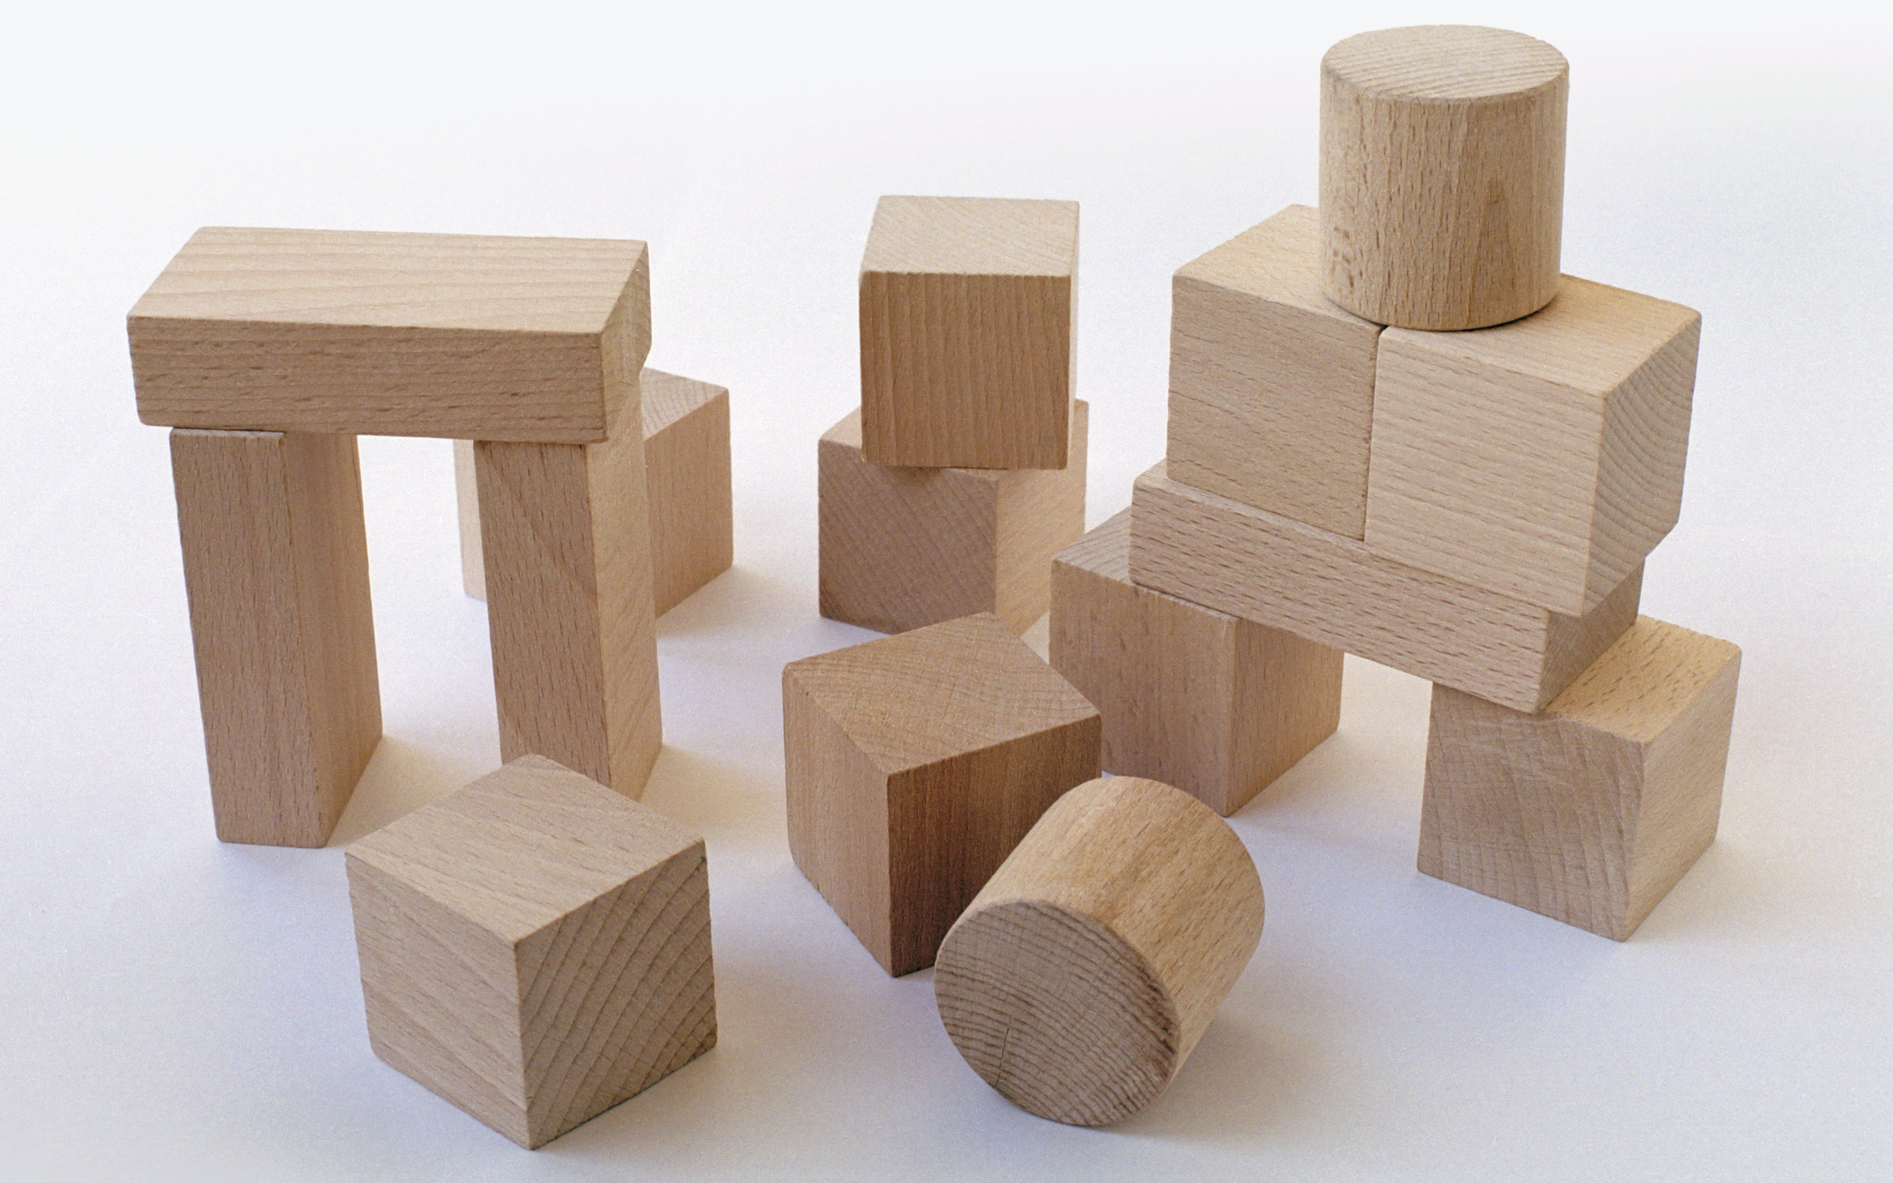
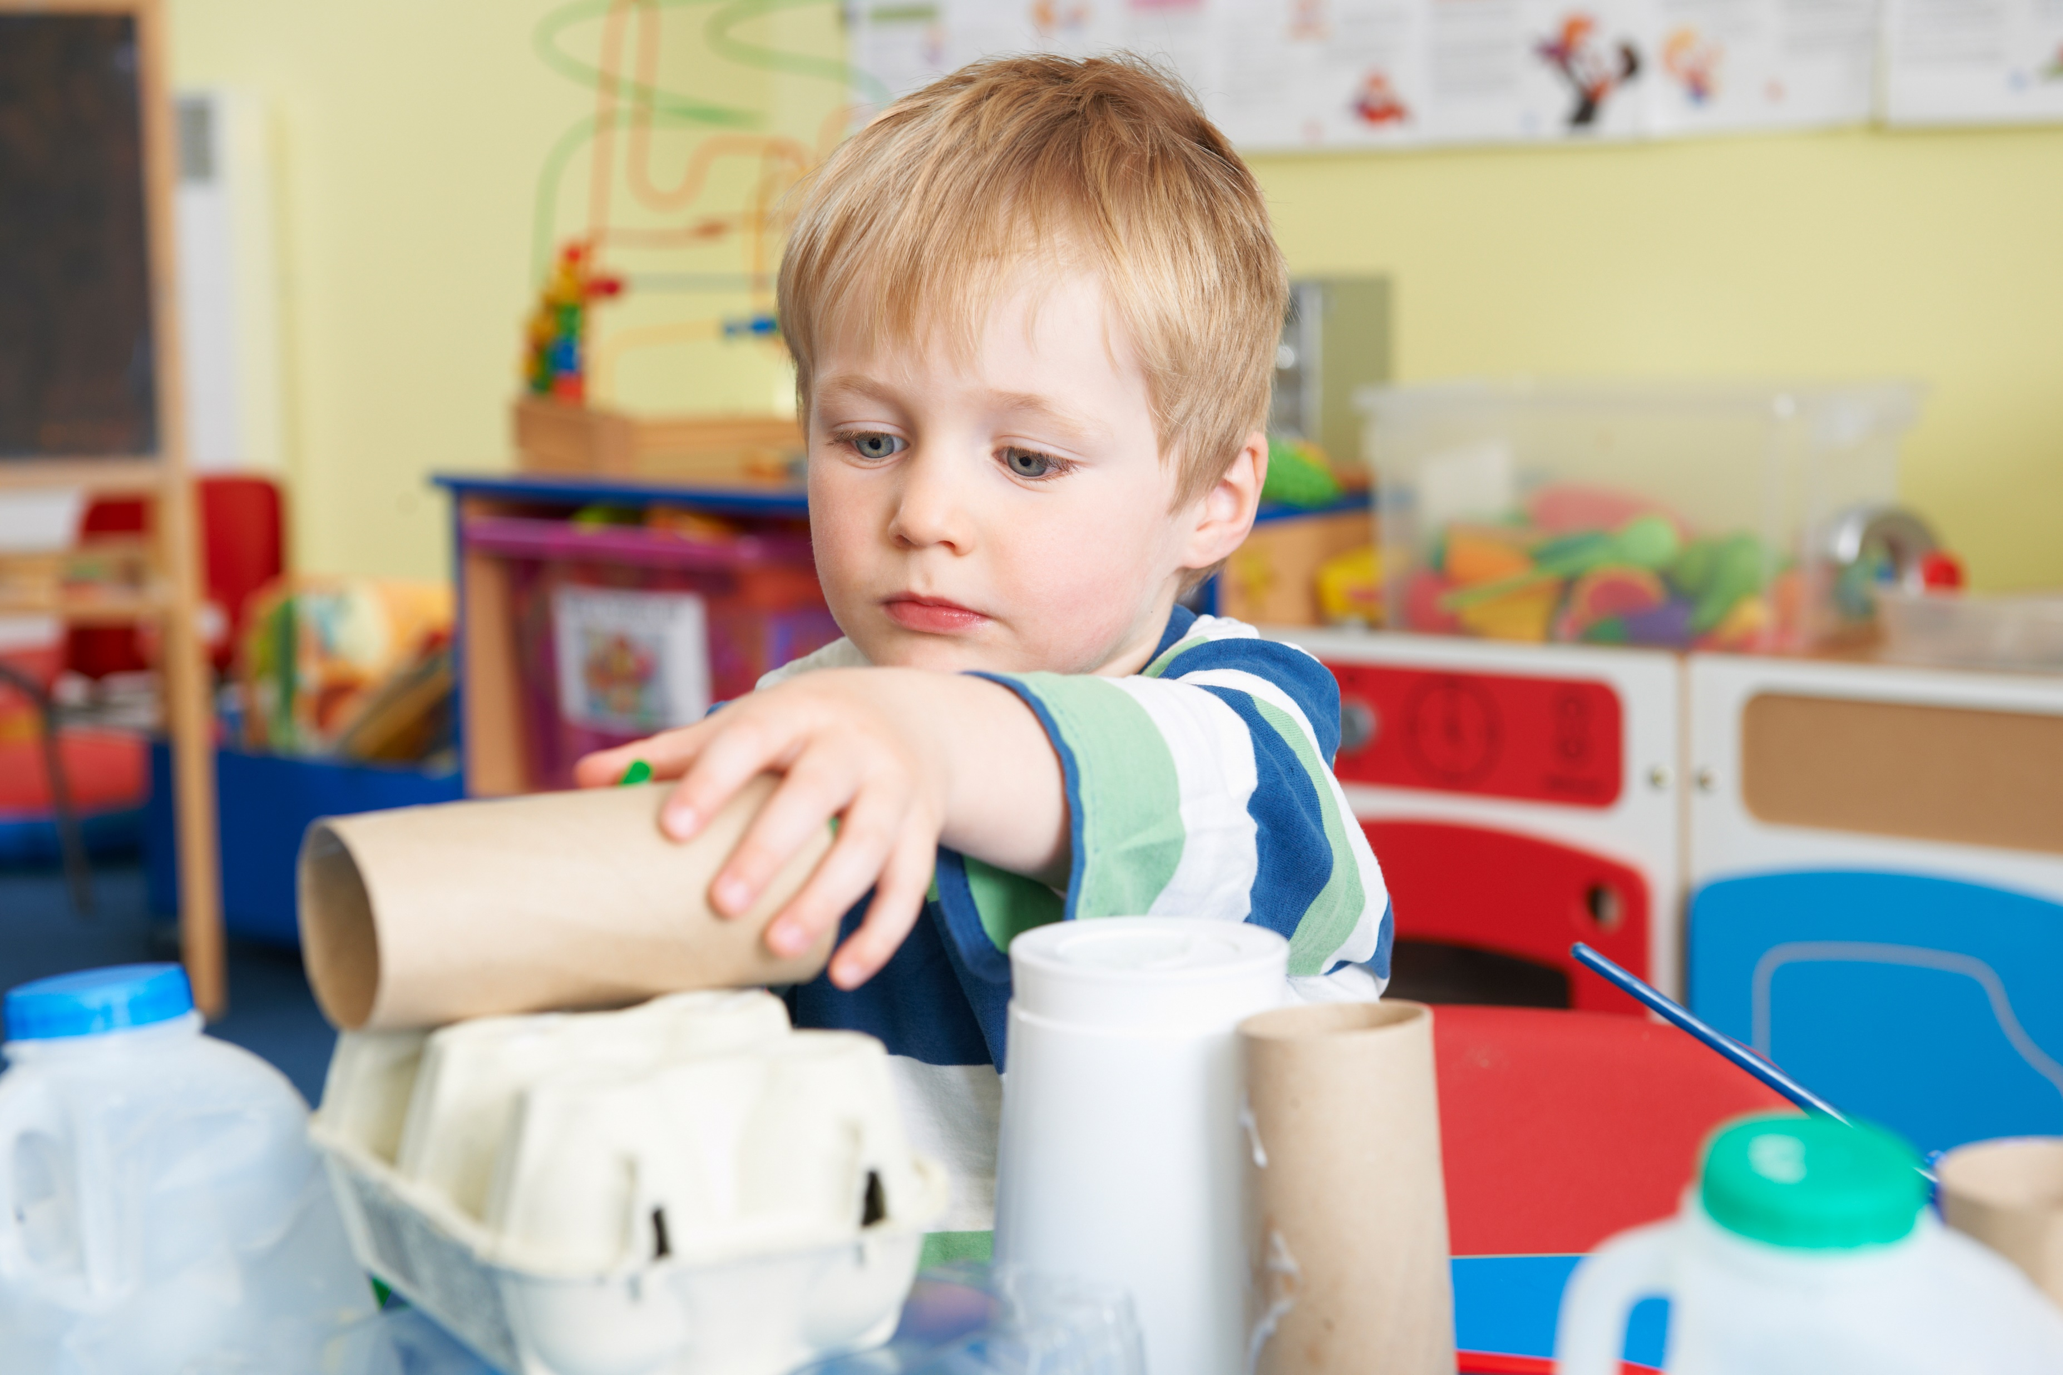

Spatial awareness
Anticipating what happens when shapes move and combine with other shapes
Developing wider mathematical thinking including problem solving
Developing rich positional and directional language.
Notes:
Spatial awareness is about anticipating what happens when shapes move and combine with other shapes, developing wider mathematical thinking including problem solving and developing rich positional and directional language. Babies start developing this awareness when they move around and make sense of the space and objects around them. Recent research links children's spatial visualising skills with the ability to develop mental images, e.g. a number line or graph which supports later attainment in mathematics.
Optional Video (42 mins)
Shape and Spatial Awareness https://youtu.be/dxu-YBYf_Yk
Optional Discussion
What activities (including stories) could support children's use of positional and directional understanding and language? (E.g. map reading, scavenger hunts, construction, cloud watching, parachute play, etc.)
Handout for practitioners
Stages of Block Play

Slide 11
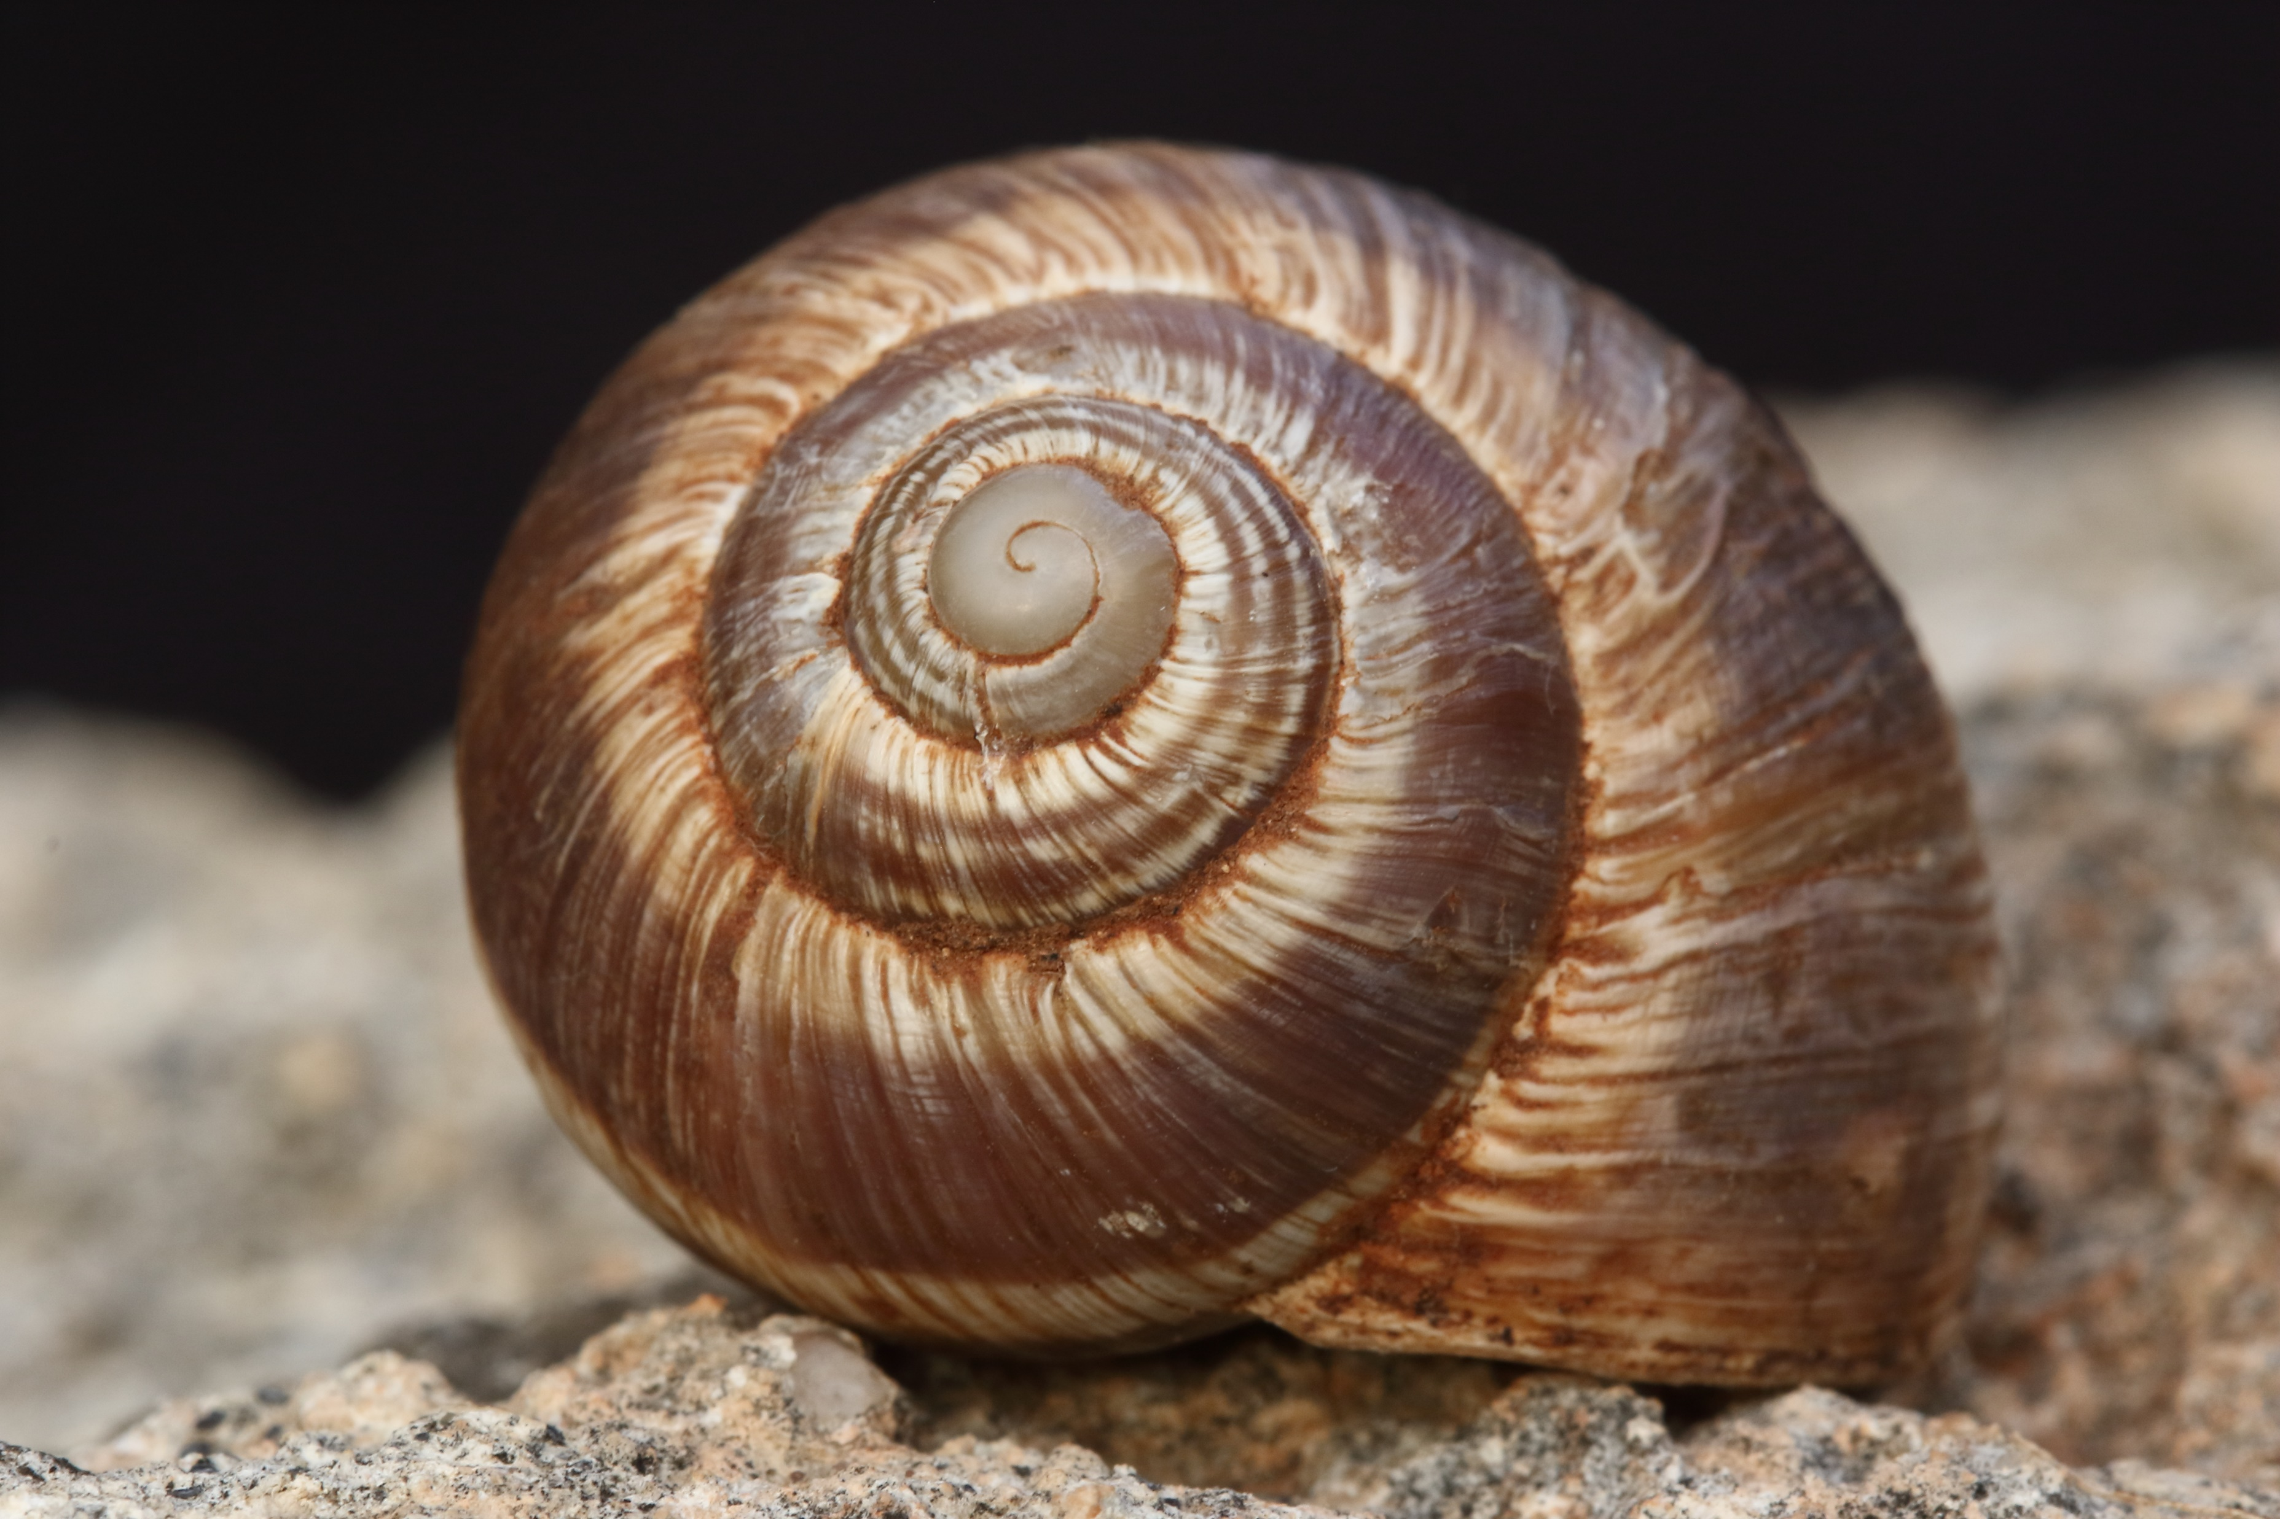


Pattern
Noticing, identifying, talking about and creating patterns
Noticing patterns where the order of some items (including sounds and actions) is continually duplicated to form a unit of repeat to generate a pattern (repeating patterns).
Notes:
Pattern understanding involves noticing, identifying, talking about and creating patterns. Noticing patterns where the order of some items (including sounds and actions) is continually duplicated to form a unit of repeat to generate a pattern (repeating patterns). For example, clap, click, clap click... with clap, click being the unit of repeat in this pattern.
The key idea to pattern is noticing regularity or sameness.
Pattern awareness has been found by researchers to be a better predictor than number understanding of children's maths achievement.
Optional Video (17 mins)
Pattern https://youtu.be/Tab6Ug89RFQ
Handout for Practitioner
NCETM Typical Progression

Slide 12
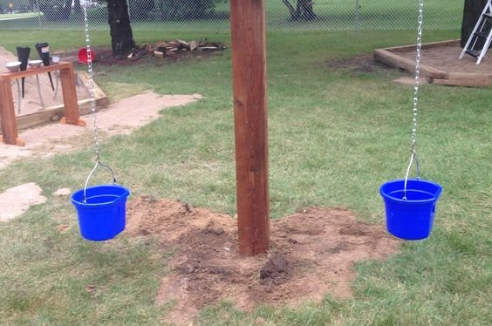
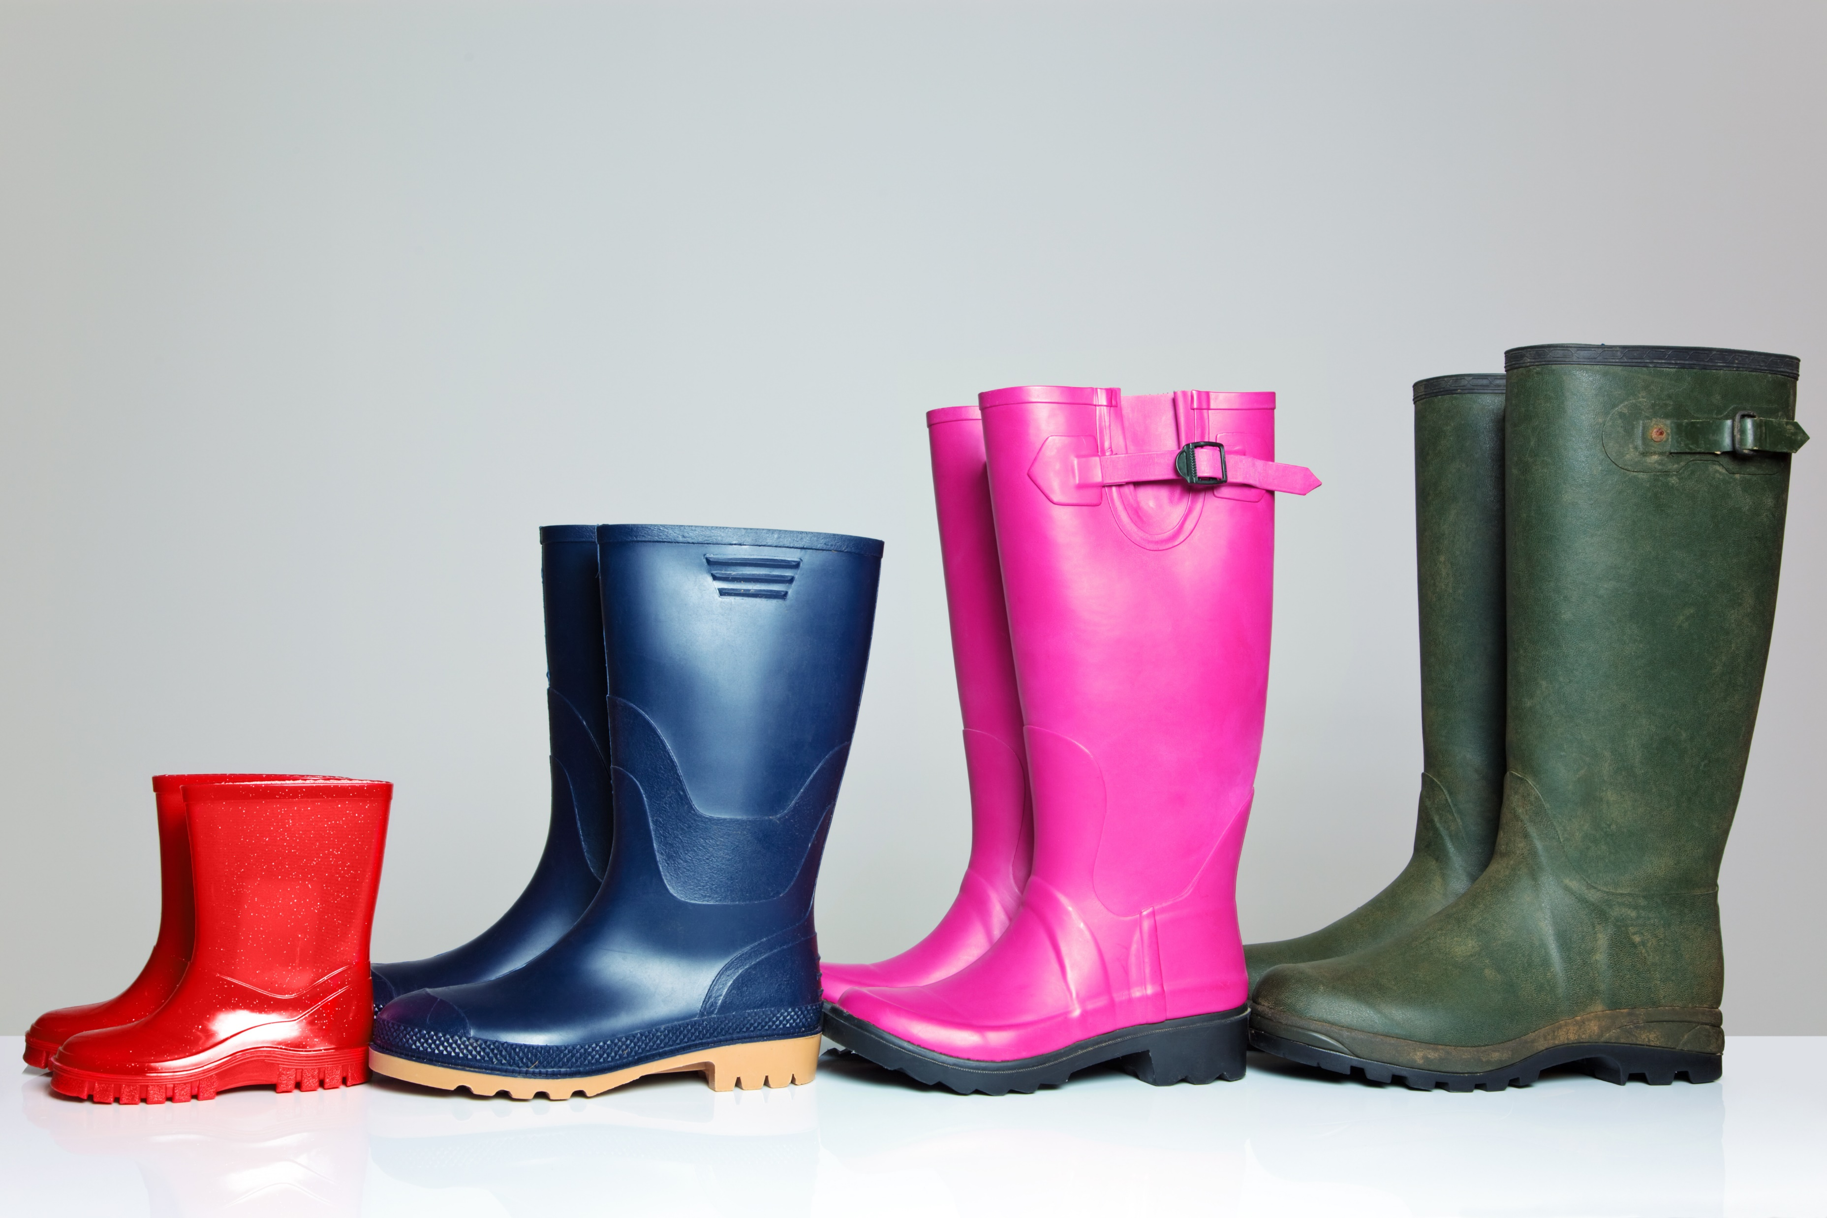
Measures
Comparing objects based on different attributes such as length, weight, size, capacity and time as a preliminary to using units to compare later.
Notes:
Measuring relates to comparing objects based on different attributes such as length, weight, size, capacity and time as a preliminary to using units to compare later.
Optional Video (23 mins)
Measures https://youtu.be/SOLy5QZQkV4
Optional discussion
How could we make water or sand play more purposeful at times and include more maths? Can you think of a problem to solve which you could present to children at the water tray?
Or
How can we support the understanding of capacity during snack time?

Slide 13

Knowledge Check
Notes:
Ask staff to take some time to complete the knowledge check questions.
Handout the answer sheet for them to check their answers after the session.
Handouts for practitioners
Knowledge check sheet
Answer sheet

Slide 14

Next steps
Audits
Action plans
Notes:
(Thank everyone for attending and engaging with the presentation).
For the next part of our Maths Champions journey, we will conduct an audit of our learning environment in relation to our maths provision and also audits of our own confidence in supporting mathematical development. This will help us understand where we are starting from and what plan what we want to do to make improvements.
(Explain how you will be implementing the audit process, e.g. sitting with individual staff members to talk through and complete the confidence audit etc.)
We will then use the audit information to select some goals for the setting.
(Explain how you will share the audit information and action plans. You may wish to involve the staff in the formation of the goals).
Share the date that you aim to complete the audits.
Ask the staff if they have any questions.
Handout for practitioners
Learning environment audit
Staff confidence audit

