Slide 1


Maths Champions Induction
Maths Champions Induction V0.2 20 September 2024

Slide 2
Aims of the session
Explore the aims of the Maths Champions programme and share the evidence-based research on the effectiveness
Identify the Maths Champion and Deputy Maths Champion and their role
Outline the core elements of the programme which all staff will be integral to
Identify next steps, including creating a statement of intent

Slide 3
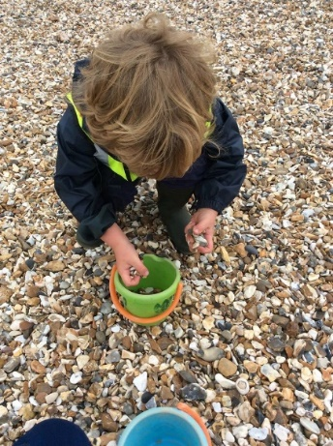
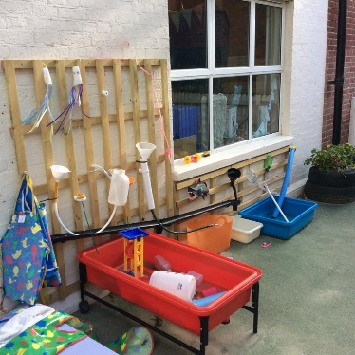
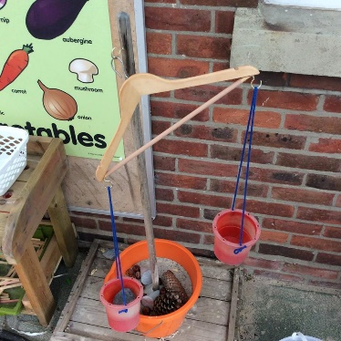
Aim of the Maths Champions programme
The aim of the Maths Champions programme is to improve practice in maths by providing access to a range of online training, evaluative tools and resources; enhancing maths practice and building the confidence, and skills, of the practitioners working with young children.
/

Slide 4
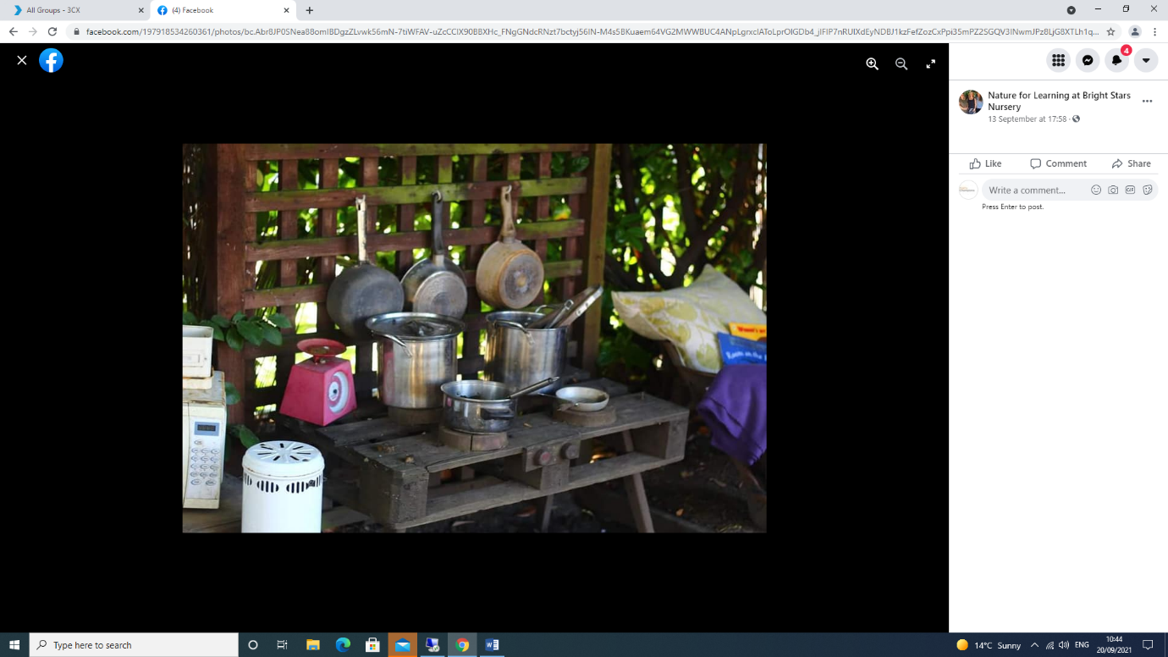
Effectiveness trial
3 months additional progress in both maths and language development
Evidence suggests EYPP children could make up to 6 months additional progress in maths
Source: EEF 2023

Slide 5

Maths Champion
and
Deputy Maths Champion

Slide 6

Core elements of the programme
Online training
Children’s observational assessment
Completed by the Maths Champion and Deputy Maths Champions with learning disseminated to all staff
Short observational assessment focusing on the key areas of math's learning for 6 children
Audits and action plans
Core activities
Learning environment and staff confidence audits and action plans
Core activities focused on supporting the key areas of math's through adult led activities and everyday routines.
Resources section
A range of tools to support knowledge and practice such as training materials, activities, useful websites, research and much more.

Slide 7
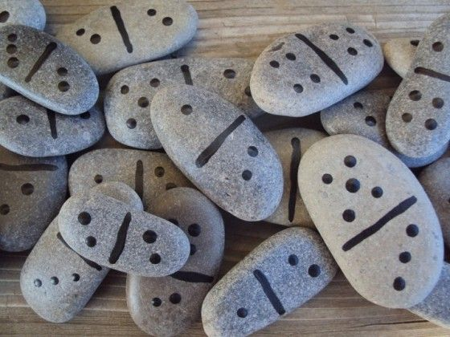
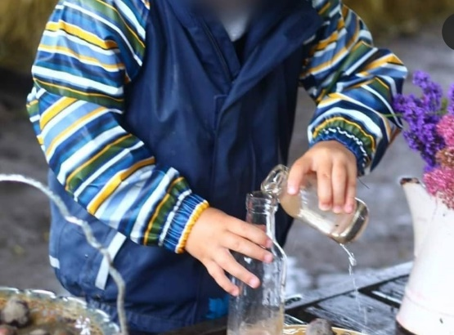
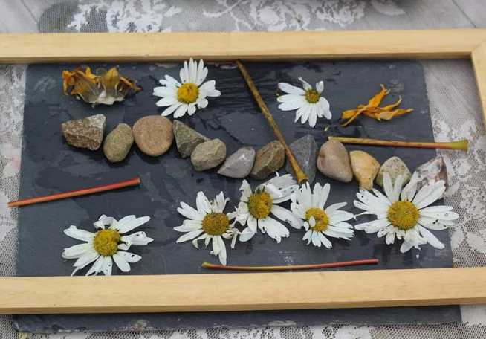
“Being involved in the Maths Champions programme has been an amazing experience and one which will impact on the children and staff for years to come.”
PVI pre-school

Slide 8

Next steps

